Slide 1
UHV-I
Session 13
Understanding our Role in Nature
Contributing towards harmony in nature

Slide 2
Interaction Before Main Session
Hear from participants about their exploration from previous day(s)
Q&A
Place some expected conclusions, find out if they also came to these/similar conclusions

Slide 3
Home Assignment
12.1. Look at your aspirations and map them to the human goal. What do you conclude from this?
12.2. Evaluate yourself on the 6 common graduate attributes.
You can do this exercise at every birthday and write down your progress year after year
12.3. Check your list of concerns. What is the root cause? Make a list of 5 things you can do to address the root cause
12.4. During your time in this institution (as a student), list 5 things you can contribute to complement your institution in realising the human goal

Slide 4
UHV-I
Session 13
Understanding our Role in Nature
Contributing towards harmony in nature

Slide 5
Introduction
So far we have explored our Natural Acceptance
It is for living in Harmony – as an Individual, as a Family, as a Society…
Is there provision in Nature/Existence for living in accordance with our Natural Acceptance?
Is it possible to live in harmony as an Individual, as a Family, as a Society…?
Is co-existence, mutual fulfillment inherent in Nature?
Or
Is the design of nature/existence by way of opposition, struggle, survival of the fittest…?
We will explore the underlying design of Nature/Existence with these questions…

Slide 6

Notes:
Link to short video on Nature (English)
https://www.youtube.com/watch?v=wHKIrq_Aux4
On Zoom:
For sharing the PPT, we just select the specific application window
But for sharing the audio, additionally we need to check the "Share sound" option

Slide 7

Notes:
Link to short video on Nature (Hindi)
https://www.youtube.com/watch?v=HqIBt7Azh1g
On Zoom:
For sharing the PPT, we just select the specific application window
But for sharing the audio, additionally we need to check the "Share sound" option

Slide 8
Nature = Collection of Units
Air
Water Trees
Soil
Animal body
Birds Animals Human body
Self(I)
Human Beings
Earth Sun
Moon Metals

Slide 9
Nature = Collection of Units = 4 Orders
All units can be categorised into 4 orders*
* This is one way of categorizing nature (not the only way). It has been classified this way so that it can be helpful in understanding the role of human being vis-à-vis the rest of nature
Bio Order
Plants, Trees
izk.k voLFkk
isM+] ikS/ks
Physical Order
Soil, Metal
inkFkZ voLFkk
feV~Vh] /kkrq
Animal Order
Animals, Birds
tho voLFkk
i”kq+] i{kh
Human Order
Human Being
Kku voLFkk
euq’;

Slide 10
Relationship of Mutual Fulfillment ijLij iwjdrk dk laca/k
Between Physical Order and Bio Order
Interconnected, Interdependent
Mutual Fulfillment
Cyclic
Every unit is enriched
Mutual Fulfillment = Relatedness + Fulfillment
ijLij iwjdrk = ijLijrk + iwjdrk
Bio Order
Plants, Trees
izk.k voLFkk
isM+] ikS/ks
Physical Order
Soil, Metal
inkFkZ voLFkk
feV~Vh] /kkrq

Slide 11
Relationship of Mutual Fulfillment ijLij iwjdrk dk laca/k
Between Physical Order, Bio Order and Animal Order
Interconnected, Interdependent
Mutual Fulfillment
Cyclic
Every unit is enriched
Bio Order
Plants, Trees
izk.k voLFkk
isM+] ikS/ks
Physical Order
Soil, Metal
inkFkZ voLFkk
feV~Vh] /kkrq
Animal Order
Animals, Birds
tho voLFkk
i”kq+] i{kh

Slide 12
Relationship of Mutual Fulfillment ijLij iwjdrk dk laca/k
Physical Order, Bio Order and Animal Order are enriching for Human Order, but Human Order (without right understanding) is not fulfilling for any of the 4 orders
Human beings have
natural acceptance
to be mutually fulfilling
Once human beings understand,
they can be fulfilling for all four orders
Bio Order
Plants, Trees
izk.k voLFkk
isM+] ikS/ks
Physical Order
Soil, Metal
inkFkZ voLFkk
feV~Vh] /kkrq
Animal Order
Animals, Birds
tho voLFkk
i”kq+] i{kh
√
?
√
?
√
?
Human Order
Human Being
Kku voLFkk
euq’;

Slide 13
Present-day Problems are largely due to Lack of Understanding
Resource Depletion – The resource is used at a rate which is faster than the rate at which it is produced in nature
lalk/ku vHkko & mRiknu esa iz;qDr laalk/ku dh xfr] mlds izÑfr esa iSnk gksus dh xfr ls T;knk gS
Pollution – The product is such that
  It does not return to the cycle in nature or
  It is produced at a rate that is faster than the rate at which it can return to the cycle in nature
iznw’k.k & mRiknu ,slk gS fd
  1- mRikfnr oLrq pØ esa okil ugha vkrh ;k
  2- mRiknu dh xfr izkÑfrd pØz esa okil tkus dh xfr ls T;knk gS

Slide 14
Harmony in Nature iz—fr esa O;oLFkk
Quantity of units in each order
Physical >> Plant >> Animal >> Human
Quantity as per overall enrichment of the whole; and availability of sustaining resources
Dependence of each order is on all
previous orders
The Human Order is
dependent on all the three orders
Role of human being is to ensure
the enrichment, protection and
right utilisation of the rest of nature
Human Order
Animal Order
Plant Order
Physical Order

Slide 15
Harmony in Nature iz—fr esa O;oLFkk
All orders have definite conduct – except human order without right understanding
In human being, the Body has a definite conduct
The Self (I) operating on assuming without knowing is the source of indefiniteness, problem
The solution is to ensure knowing
(understanding harmony)
Human beings inherently have a
natural acceptance to know,
to be in harmony
For this,
human education-sanskar
Is essential
Human Order
Animal Order
Plant Order
Physical Order

Slide 16
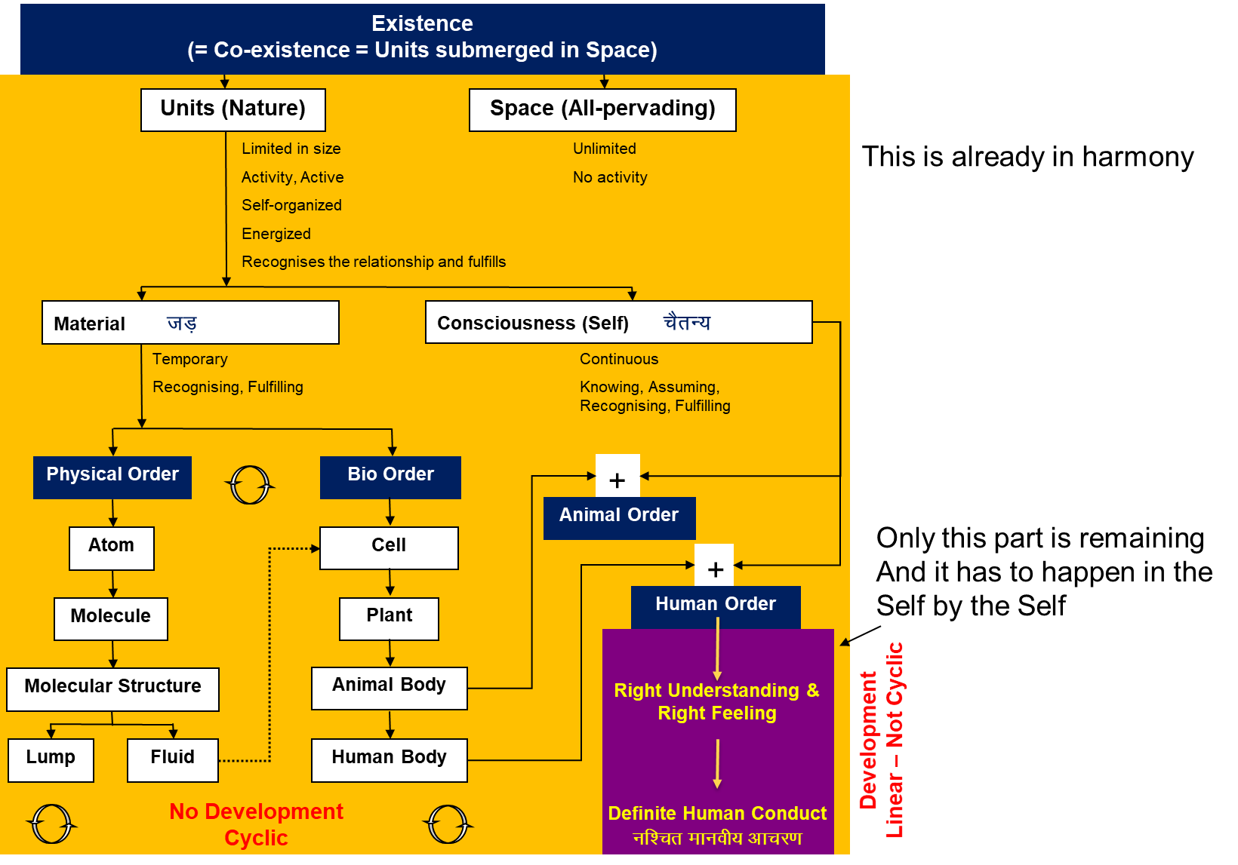
Existence = Nature (units) Submerged in Space
Human being is a small part of this existence
Except for the human being without right understanding, every other unit is in harmony and participating in the larger harmony
All the human being has to do is to understand harmony (develop right understanding, right feeling) and live in harmony (participate for harmony in the family, society, nature)!
In UHV-II, we will discuss this in more detail

Slide 17
Sum Up
Physical order – soil, metals etc.
Bio order – trees, plants etc.
Animal order – animals, birds etc.
Human order – human beings
There is a relationship of mutual fulfilment (harmony) amongst these 4 orders. The first 3 orders are mutually fulfilling for each other. They are fulfilling for human being also. It is naturally acceptable to human beings to be fulfilling for all the orders
The role of human being is to realize this mutual fulfilment – For this, all that human beings need to do is:
  To understand that mutual fulfilment (harmony) is inherent in nature/existence – we do not have to create it
  To live accordingly – then the mutual fulfilment amongst the 4 orders will be realised
      i.e., to ensure the enrichment, protection and right utilisation of the rest of nature
and there is provision in nature/existence for living with mutual fulfilment (harmony)
In UHV-II, we will discuss the whole existence. And our role in this existence – in more detail
Nature = Collection of Units
= 4 Orders
Relationship of mutual fulfilment (harmony)

Slide 18
Home Assignment

Slide 19
Home Assignment
13.1. Detail out 3 activities or projects that you can do to contribute to the harmony in nature?
(during the time in the institute, implement at least one of them. It could well be your final year project)
We can see that global warming and resource depletion are two major problems of the current time. Find out
- Are these natural occurrences or are they due to lack of right understanding in human being?
- Do we, human beings, have a role to play in nature?
    To further develop the harmony in nature (at least not to disturb the harmony in nature)
    To make right utilisation of the physical facility (after all it comes from the rest of nature)
    To evolve a way of living in harmony with nature

Slide 20
Questions?

Slide 21
Harmony in Existence vfLrRo esa O;oLFkk
vfLrRo ¾ vfLr + + Ro
↓ ↓
gS@gksuk O;oLFkk
Existence = Exist + Essence
Whatever ↓ ↓
Exists is/to be harmony (mutual fulfillment)
vfLrRo ¾ lg&vfLrRo ¾ “kwU; esa lai`Dr bdkb;ka
Existence = Co- Existence = Units submerged in Space

Slide 22
Harmony in Existence vfLrRo esa O;oLFkk
Existence vfLrRo =
Units Submerged in Space Ever Present
bdkb;ka lai`Dr “kwU;
Limited in Size lhfer vkdkj Unlimited vlhe
(All Pervading, O;kid)
Activity, Active fØ;k] fØ;k'khy No Activity fØ;k”kwU; ¼“kwU;½
  1. Energised in Space (“kwU; ds lg&vfLrRo esa ÅftZr gS)
  2. Self organised in Space (“kwU; ds lg&vfLrRo esa fu;af=r gS] Lo;a esa O;oLFkk gS)
  3. Recognises it's relationship,
  Fulfills its relationship with every other Unit in Space
  (“kwU; ds lg&vfLrRo esa ijLijrk dks igpkurh gS] fuokZg djrh gS
  cMh O;oLFkk esa Hkkxhnkj gS] lexz O;oLFkk esa Hkkxhnkj gS)
CO-EXISTENCE
lg&vfLrRo

Slide 23
Existence
(= Co-existence = Units submerged in Space)
Units (Nature)
Space (All-pervading)
Limited in size
Unlimited
This is already in harmony
Activity, Active
No activity
Self-organized
Energized
Recognises the relationship and fulfills
Material tM+
Consciousness (Self) pSrU;
Temporary
Continuous
Recognising, Fulfilling
Knowing, Assuming, Recognising, Fulfilling
Physical Order
Bio Order
+
Animal Order
Atom
Cell
Only this part is remaining
And it has to happen in the Self by the Self
+
Molecule
Plant
Human Order
Molecular Structure
Animal Body
Right Understanding &
Right Feeling
Development
Linear – Not Cyclic
Lump
Fluid
Human Body
No Development
Cyclic
Definite Human Conduct
uf”pr Ekkuoh; vkpj.k

Slide 24
Sum Up
Existence is in the form of co-existence. It is ever present
(Existence = Co- Existence = Units submerged in Space)
Every unit in existence is related with every other unit in existence in a mutually fulfilling manner
Synergy is intrinsic to existence, harmony is inherent in existence – we do not have to create it, we do not have to construct it
The role of Human Being is to realize this co-existence, this harmony, this order in existence.
For this, all that human beings need to do is:
  To understand the inherent harmony, the co-existence in existence
  To live accordingly – to live with the feeling of harmony or co-existence (and there is every provision in existence for living in co-existence)

